Slide 1

Notes:
Reload codespace
Uncheck VS Code tabs

Slide 2
This is CS50
Visit cs50.ly/screen to view projector on your laptop and ask questions via chat.
If you didn't get a rubber duck 🦆 last week, ask Carter during break or after class!
Brownies for snacks today!
No CS50 Lunch this Friday but yes next week.
To learn about "prompt engineering," register for Ready Player 50 at cs50.ly/register!
Do say hi or ask questions during break or after class!

Slide 3
new emoji coming soon!

Slide 4

Notes:
https://twitter.com/unicode/status/1699385767980888229
http://blog.unicode.org/2023/01/whats-new-in-emoji-151.html

Slide 5
Notes:
Reload codespace
Uncheck VS Code tabs

Slide 6
learn how to think algorithmically

Slide 7
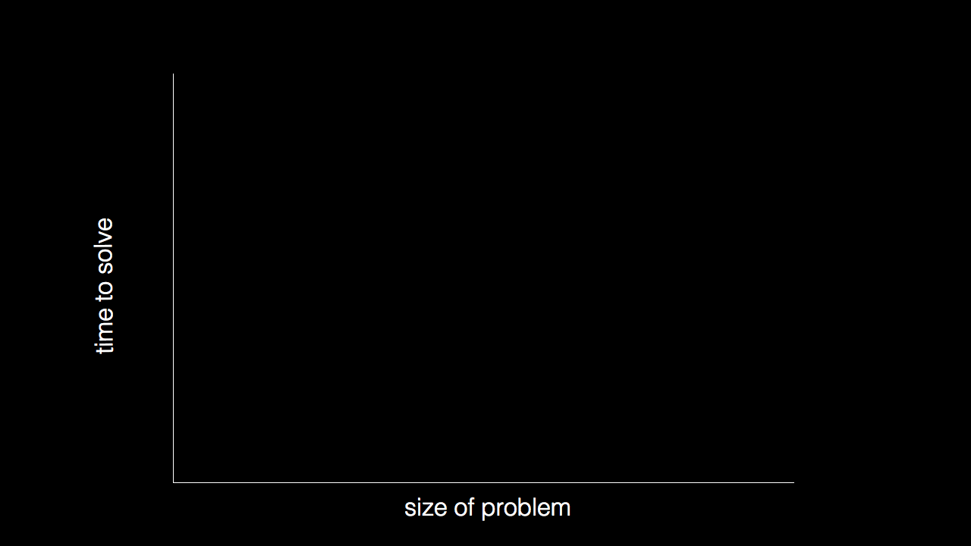

Slide 8
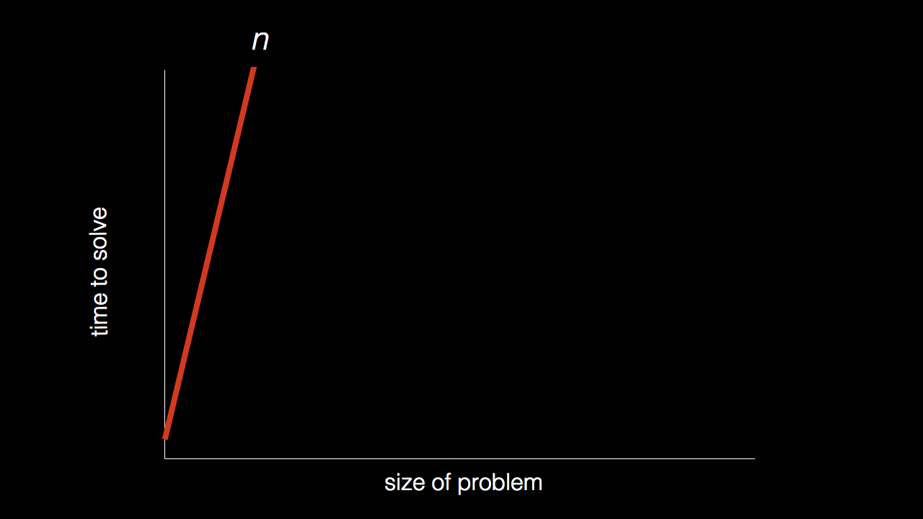
n

Slide 9
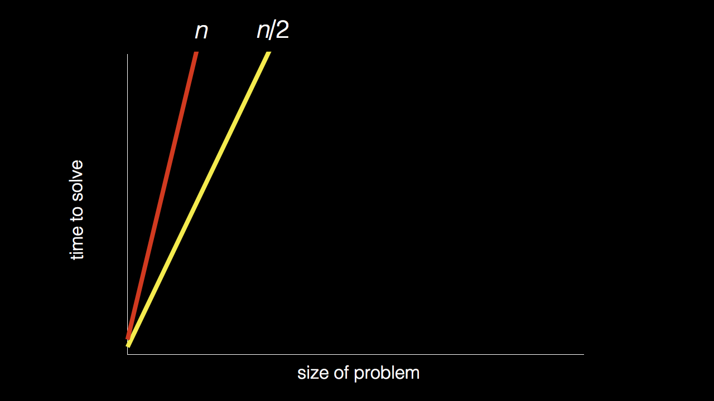
n
n/2

Slide 10
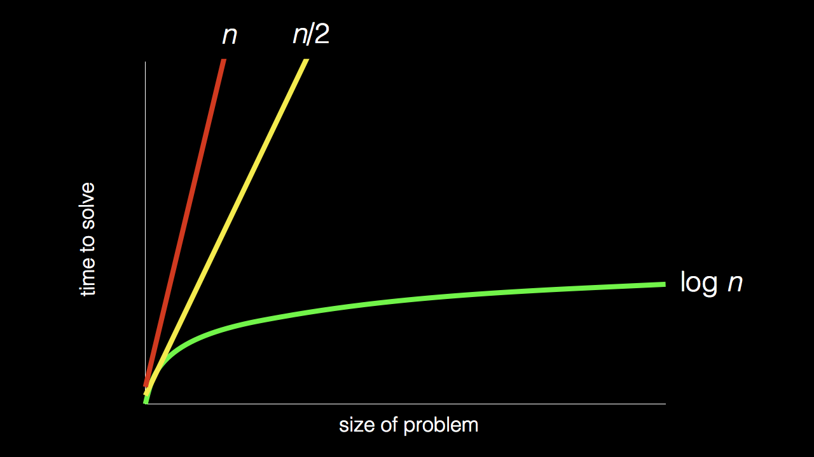
n
n/2
log₂ n

Slide 11
Stand up and think of the number 1.

Slide 12
Stand up and think of the number 1.
Pair off with someone standing, add their number to yours, and remember the sum.

Slide 13
Stand up and think of the number 1.
Pair off with someone standing, add their number to yours, and remember the sum.
One of you should then sit down.

Slide 14
Stand up and think of the number 1.
Pair off with someone standing, add their number to yours, and remember the sum.
One of you should then sit down.
If still standing, go back to step 2.

Slide 15

Notes:
https://apps.apple.com/us/app/contacts/id1069512615#?platform=iphone
In Week 0, intuitive algorithms…
John Harvard

Slide 16
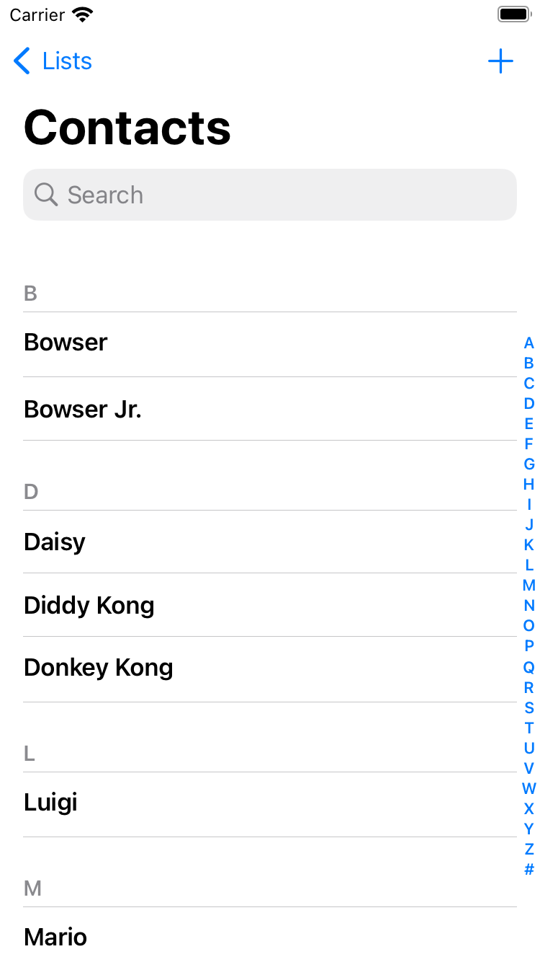
Notes:
https://nintendo.fandom.com/wiki/Nintendo_characters#Mario_series_(including_sub-franchises)

Slide 17
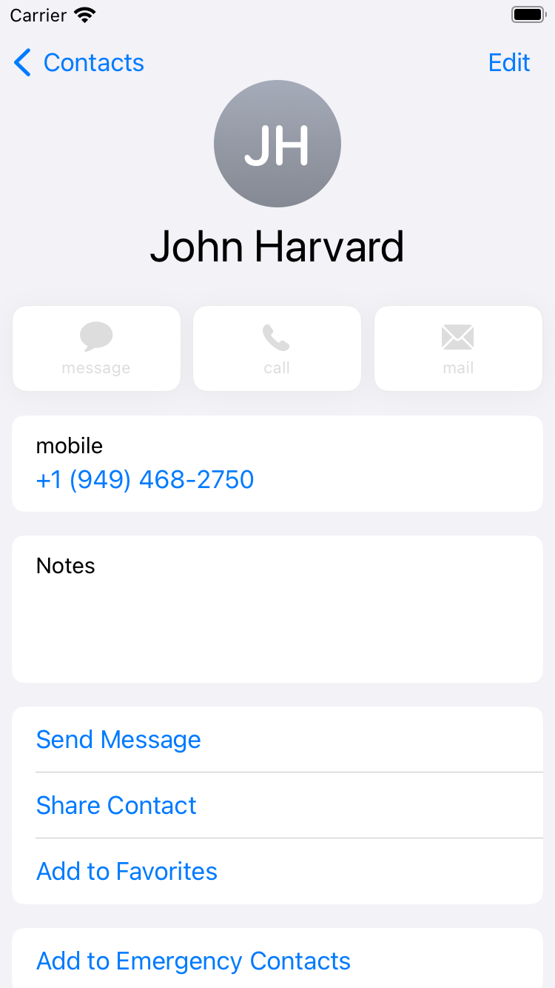

Slide 18
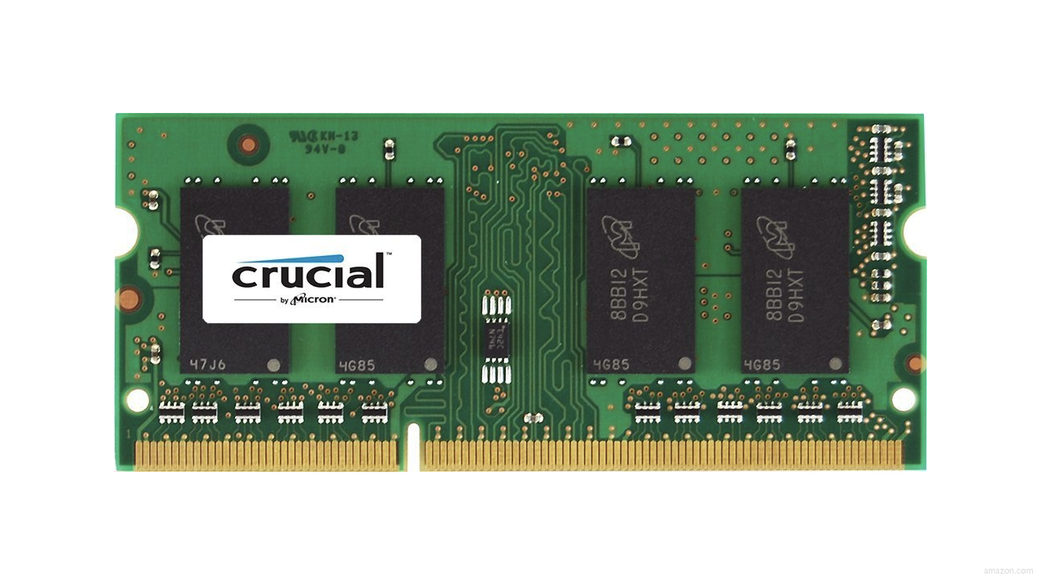

Slide 22
 | 1 | 5 | 10 | 20 | 50 | 100 | 500

Slide 24
 | [0] | [1] | [2] | [3] | [4] | [5] | [6]

Slide 25
 | [0] | [1] | [2] | [3] | [4] | [5] | [6]

Slide 26
searching

Slide 27
input →
→ output

Slide 28

→
→ output

Slide 29
→
→ bool

Slide 30
algorithm

Slide 31

Notes:
https://www.etsy.com/listing/926075105/monopoly-money-vintage-fabric-half-yard

Slide 32
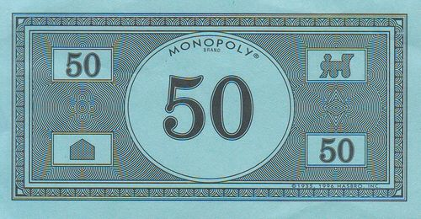
Notes:
https://www.pinterest.com/pin/525443481522247447/

Slide 33
linear search
Notes:
20 500 10 5 100 1 50

Slide 34
For each door from left to right
If 50 is behind door
Return true
Return false

Slide 35
For each door from left to right
If 50 is behind door
Return true
Else
Return false

Slide 36
For each door from left to right
If 50 is behind door
Return true
Return false

Slide 37
For i from 0 to n-1
If 50 is behind doors[i]
Return true
Return false

Slide 38
Notes:
https://www.pinterest.com/pin/525443481522247447/

Slide 39
binary search
Notes:
1 5 10 20 50 100 500

Slide 40
If 50 is behind middle door
Return true
Else if 50 < middle door
Search left half
Else if 50 > middle door
Search right half

Slide 41
If no doors left
If 50 is behind middle door
Return true
Else if 50 < middle door
Search left half
Else if 50 > middle door
Search right half

Slide 42
If no doors left
Return false
If 50 is behind middle door
Return true
Else if 50 < middle door
Search left half
Else if 50 > middle door
Search right half

Slide 43
If no doors left
Return false
If 50 is behind doors[middle]
Return true
Else if 50 < doors[middle]
Search doors[0] through doors[middle - 1]
Else if 50 > doors[middle]
Search doors[middle + 1] through doors[n - 1]

Slide 44
running time

Slide 45
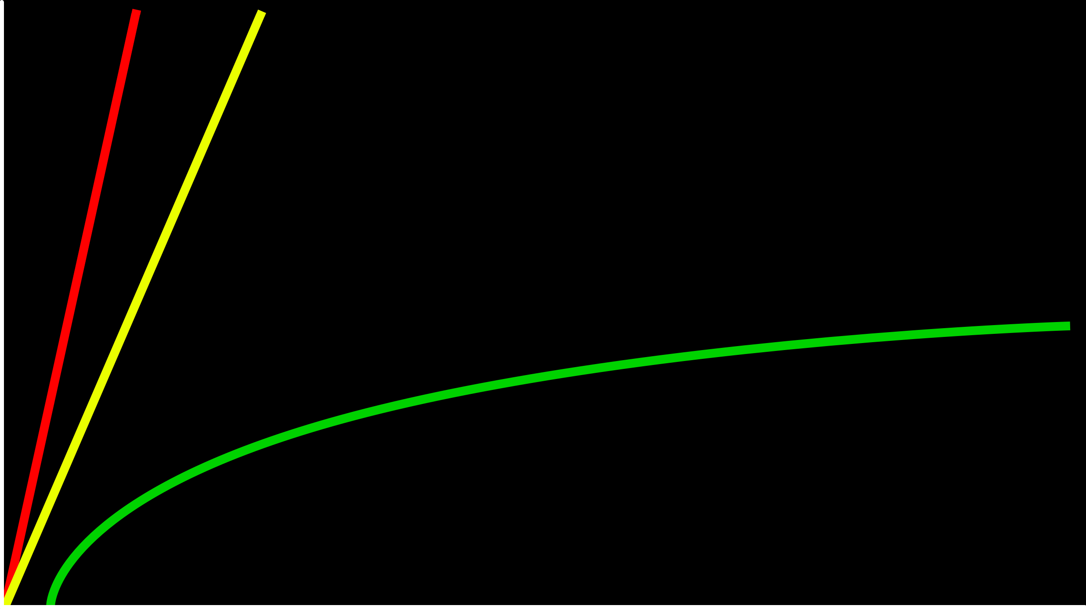
time to solve
size of problem

Slide 46
O(n)
O(n/2)
time to solve
O(log₂n)
size of problem

Slide 47
O(n)
O(n/2)
time to solve
O(log₂n)
size of problem

Slide 48
O(n)
O(n)
time to solve
O(log₂n)
size of problem

Slide 49
O(n)
O(n)
time to solve
O(log n)
size of problem

Slide 50
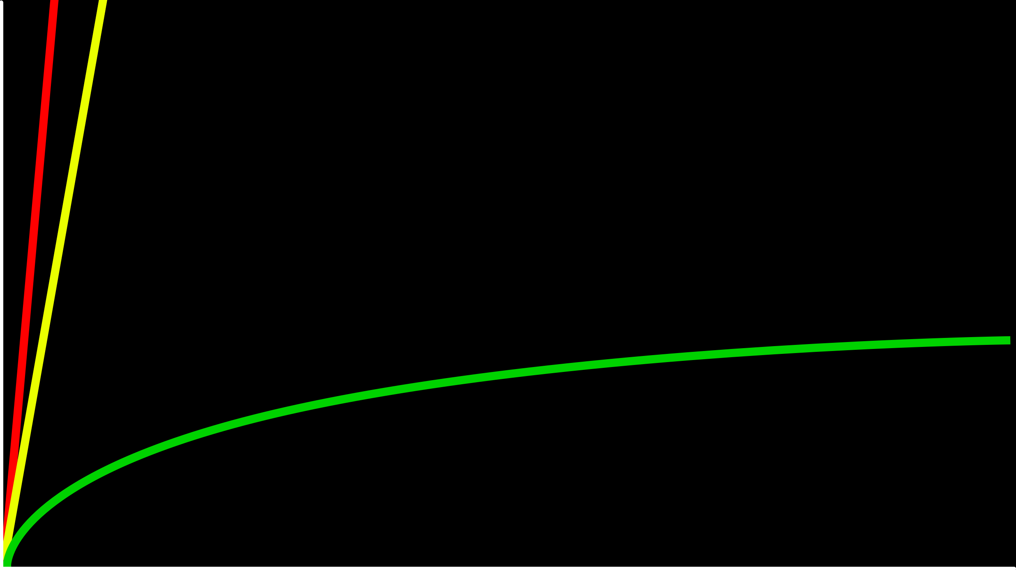
O(n)
time to solve
O(log n)
size of problem

Slide 51
O

Slide 52
O(n²)
O(n log n)
O(n)
O(log n)
O(1)
Notes:
linear? binary?

Slide 53
O(n²)
O(n log n)
O(n) linear search
O(log n)
O(1)

Slide 54
O(n²)
O(n log n)
O(n) linear search
O(log n) binary search
O(1)

Slide 55
Ω

Slide 56
Ω(n²)
Ω(n log n)
Ω(n)
Ω(log n)
Ω(1)
Notes:
linear? binary?

Slide 57
Ω(n²)
Ω(n log n)
Ω(n)
Ω(log n)
Ω(1) linear search

Slide 58
Ω(n²)
Ω(n log n)
Ω(n)
Ω(log n)
Ω(1) linear search, binary search

Slide 59
Θ

Slide 60
Θ(n²)
Θ(n log n)
Θ(n)
Θ(log n)
Θ(1)

Slide 61
linear search
Notes:
search{0,1}.c

Slide 62
string.h

Slide 63
manual.cs50.io/#string.h

Slide 64
strcmp
Notes:
phonebook0.c

Slide 65
data structures

Slide 66
person people[]

Slide 67
string name;
string number;

Slide 68
typedef struct
{
string name;
string number;
}
person;
Notes:
phonebook1.c
we'll see a way to save phonebook eventually

Slide 69
typedef struct
{
string name;
string number;
} person;

Slide 70
sorting

Slide 71
input →
→ output

Slide 72
unsorted →
→ output

Slide 73
unsorted →
→ sorted

Slide 74
→
→ sorted
7 2 5 4 1 6 0 3

Slide 75
→
→
7 2 5 4 1 6 0 3
0 1 2 3 4 5 6 7

Slide 76
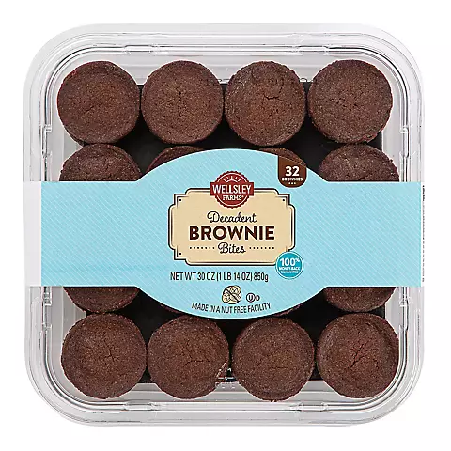

Slide 77
→
→
7 2 5 4 1 6 0 3
0 1 2 3 4 5 6 7

Slide 78
7 2 5 4 1 6 0 3
Notes:
volunteers: sort themselves, then selection, then bubble

Slide 79
selection sort
Notes:
https://www.cs.usfca.edu/~galles/visualization/ComparisonSort.html

Slide 80
7 2 5 4 1 6 0 3

Slide 81
For i from 0 to n-1
Find smallest number between numbers[i] and numbers[n-1]
Swap smallest number with numbers[i]

Slide 82
 | [0] | [1] | [2] | ... | [n-3] | [n-2] | [n-1]

Slide 84
(n – 1)

Slide 85
(n – 1) + (n – 2)

Slide 86
(n – 1) + (n – 2) + (n – 3)

Slide 87
(n – 1) + (n – 2) + (n – 3) + ... + 1

Slide 88
(n – 1) + (n – 2) + (n – 3) + ... + 1
n(n – 1)/2

Slide 89
(n – 1) + (n – 2) + (n – 3) + ... + 1
n(n – 1)/2
(n² – n)/2

Slide 90
(n – 1) + (n – 2) + (n – 3) + ... + 1
n(n – 1)/2
(n² – n)/2
n²/2 – n/2

Slide 91
(n – 1) + (n – 2) + (n – 3) + ... + 1
n(n – 1)/2
(n² – n)/2
n²/2 – n/2
O(n²)

Slide 92
O(n²)
O(n log n)
O(n)
O(log n)
O(1)

Slide 93
O(n²) selection sort
O(n log n)
O(n)
O(log n)
O(1)

Slide 94
For i from 0 to n-1
Find smallest number between numbers[i] and numbers[n-1]
Swap smallest number with numbers[i]
Notes:
what about lower bound?

Slide 95
 | [0] | [1] | [2] | ... | [n-3] | [n-2] | [n-1]

Slide 96
Ω(n²)
Ω(n log n)
Ω(n)
Ω(log n)
Ω(1)

Slide 97
Ω(n²) selection sort
Ω(n log n)
Ω(n)
Ω(log n)
Ω(1)

Slide 98
Θ(n²)
Θ(n log n)
Θ(n)
Θ(log n)
Θ(1)

Slide 99
Θ(n²) selection sort
Θ(n log n)
Θ(n)
Θ(log n)
Θ(1)

Slide 100
bubble sort
Notes:
https://www.cs.usfca.edu/~galles/visualization/ComparisonSort.html

Slide 101
7 2 5 4 1 6 0 3

Slide 102
Repeat n times
For i from 0 to n-2
If numbers[i] and numbers[i+1] out of order
Swap them
Notes:
https://www.cs.usfca.edu/~galles/visualization/ComparisonSort.html

Slide 103
Repeat n-1 times
For i from 0 to n-2
If numbers[i] and numbers[i+1] out of order
Swap them
Notes:
https://www.cs.usfca.edu/~galles/visualization/ComparisonSort.html

Slide 104
 | [0] | [1] | [2] | ... | [n-3] | [n-2] | [n-1]

Slide 106
(n – 1) × (n – 1)

Slide 107
(n – 1) × (n – 1)
n² – 1n – 1n + 1

Slide 108
(n – 1) × (n – 1)
n² – 1n – 1n + 1
n² – 2n + 1

Slide 109
(n – 1) × (n – 1)
n² – 1n – 1n + 1
n² – 2n + 1
O(n²)

Slide 110
O(n²)
O(n log n)
O(n)
O(log n)
O(1)

Slide 111
O(n²) bubble sort
O(n log n)
O(n)
O(log n)
O(1)

Slide 112
Repeat n-1 times
For i from 0 to n-2
If numbers[i] and numbers[i+1] out of order
Swap them

Slide 113
Repeat n-1 times
For i from 0 to n-2
If numbers[i] and numbers[i+1] out of order
Swap them
If no swaps
Quit

Slide 114
Ω(n²)
Ω(n log n)
Ω(n)
Ω(log n)
Ω(1)

Slide 115
Ω(n²)
Ω(n log n)
Ω(n) bubble sort
Ω(log n)
Ω(1)

Slide 116
recursion

Slide 117
If no doors left
Return false
If number behind middle door
Return true
Else if number < middle door
Search left half
Else if number > middle door
Search right half

Slide 118
If no doors left
Return false
If number behind middle door
Return true
Else if number < middle door
Search left half
Else if number > middle door
Search right half

Slide 119
1 Pick up phone book
2 Open to middle of phone book
3 Look at page
4 If person is on page
5 Call person
6 Else if person is earlier in book
7 Open to middle of left half of book
8 Go back to line 3
9 Else if person is later in book
10 Open to middle of right half of book
11 Go back to line 3
12 Else
13 Quit

Slide 120
1 Pick up phone book
2 Open to middle of phone book
3 Look at page
4 If person is on page
5 Call person
6 Else if person is earlier in book
7 Open to middle of left half of book
8 Go back to line 3
9 Else if person is later in book
10 Open to middle of right half of book
11 Go back to line 3
12 Else
13 Quit

Slide 121
1 Pick up phone book
2 Open to middle of phone book
3 Look at page
4 If person is on page
5 Call person
6 Else if person is earlier in book
7 Open to middle of left half of book
8 Go back to line 3
9 Else if person is later in book
10 Open to middle of right half of book
11 Go back to line 3
12 Else
13 Quit

Slide 122
1 Pick up phone book
2 Open to middle of phone book
3 Look at page
4 If person is on page
5 Call person
6 Else if person is earlier in book
7 Search left half of book
8
9 Else if person is later in book
10 Search right half of book
11
12 Else
13 Quit

Slide 123
1 Pick up phone book
2 Open to middle of phone book
3 Look at page
4 If person is on page
5 Call person
6 Else if person is earlier in book
7 Search left half of book
8 Else if person is later in book
9 Search right half of book
10 Else
11 Quit

Slide 124

Notes:
http://ian-albert.com/games/super_mario_bros_maps/

Slide 125

Notes:
iteration.c

Slide 126


Slide 127


Slide 128


Slide 129

Notes:
recursion{0,1}.c

Slide 130
google.com/search?q=recursion

Slide 131
merge sort

Slide 132
Sort left half of numbers
Sort right half of numbers
Merge sorted halves

Slide 133
If only one number
Quit
Else
Sort left half of numbers
Sort right half of numbers
Merge sorted halves

Slide 134
If only one number
Quit
Else
Sort left half of numbers
Sort right half of numbers
Merge sorted halves

Slide 135
1 3 4 6 0 2 5 7
Notes:
shelves

Slide 136
If only one number
Quit
Else
Sort left half of numbers
Sort right half of numbers
Merge sorted halves
Notes:
https://www.cs.usfca.edu/~galles/visualization/ComparisonSort.html

Slide 137
6 3 4 1 5 2 7 0
Notes:
shelves

Slide 138
6 | 3 | 4 | 1 | 5 | 2 | 7 | 0

Slide 139
6 | 3 | 4 | 1 | 5 | 2 | 7 | 0

Slide 140
 |  |  |  | 5 | 2 | 7 | 0
6 | 3 | 4 | 1

Slide 141
 |  |  |  | 5 | 2 | 7 | 0
 |  | 4 | 1
6 | 3

Slide 142
 |  |  |  | 5 | 2 | 7 | 0
 |  | 4 | 1
 | 3
6

Slide 143
 |  |  |  | 5 | 2 | 7 | 0
 |  | 4 | 1
6
3

Slide 144
 |  |  |  | 5 | 2 | 7 | 0
 |  | 4 | 1
3
6

Slide 145
 |  |  |  | 5 | 2 | 7 | 0
 |  | 4 | 1
3 | 6

Slide 146
 |  |  |  | 5 | 2 | 7 | 0
3 | 6
4 | 1

Slide 147
 |  |  |  | 5 | 2 | 7 | 0
3 | 6
 | 1
4

Slide 148
 |  |  |  | 5 | 2 | 7 | 0
3 | 6
4
1

Slide 149
 |  |  |  | 5 | 2 | 7 | 0
3 | 6
1
4

Slide 150
 |  |  |  | 5 | 2 | 7 | 0
3 | 6
1 | 4

Slide 151
 |  |  |  | 5 | 2 | 7 | 0
1
3 | 6
 | 4

Slide 152
 |  |  |  | 5 | 2 | 7 | 0
1 | 3
 | 6
 | 4

Slide 153
 |  |  |  | 5 | 2 | 7 | 0
1 | 3 | 4
 | 6

Slide 154
 |  |  |  | 5 | 2 | 7 | 0
1 | 3 | 4 | 6

Slide 155
1 | 3 | 4 | 6
5 | 2 | 7 | 0

Slide 156
1 | 3 | 4 | 6
 |  | 7 | 0
5 | 2

Slide 157
1 | 3 | 4 | 6
 |  | 7 | 0
 | 2
5

Slide 158
1 | 3 | 4 | 6
 |  | 7 | 0
5
2

Slide 159
1 | 3 | 4 | 6
 |  | 7 | 0
2
5

Slide 160
1 | 3 | 4 | 6
 |  | 7 | 0
2 | 5

Slide 161
1 | 3 | 4 | 6
2 | 5
7 | 0

Slide 162
1 | 3 | 4 | 6
2 | 5
 | 0
7

Slide 163
1 | 3 | 4 | 6
2 | 5
7
0

Slide 164
1 | 3 | 4 | 6
2 | 5
0
7

Slide 165
1 | 3 | 4 | 6
2 | 5
0 | 7

Slide 166
1 | 3 | 4 | 6
0
2 | 5
 | 7

Slide 167
1 | 3 | 4 | 6
0 | 2
 | 5
 | 7

Slide 168
1 | 3 | 4 | 6
0 | 2 | 5
 | 7

Slide 169
1 | 3 | 4 | 6
0 | 2 | 5 | 7

Slide 170
0
1 | 3 | 4 | 6
 | 2 | 5 | 7

Slide 171
0 | 1
 | 3 | 4 | 6
 | 2 | 5 | 7

Slide 172
0 | 1 | 2
 | 3 | 4 | 6
 |  | 5 | 7

Slide 173
0 | 1 | 2 | 3
 |  | 4 | 6
 |  | 5 | 7

Slide 174
0 | 1 | 2 | 3 | 4
 |  |  | 6
 |  | 5 | 7

Slide 175
0 | 1 | 2 | 3 | 4 | 5
 |  |  | 6
 |  |  | 7

Slide 176
0 | 1 | 2 | 3 | 4 | 5 | 6
 |  |  | 7

Slide 177
0 | 1 | 2 | 3 | 4 | 5 | 6 | 7

Slide 178
0 | 1 | 2 | 3 | 4 | 5 | 6 | 7

Slide 179
O(n²)
O(n log n)
O(n)
O(log n)
O(1)

Slide 180
6 | 3 | 4 | 1 | 5 | 2 | 7 | 0
6 | 3 | 4 | 1
5 | 2 | 7 | 0
6 | 3
4 | 1
5 | 2
7 | 0
6
3
4
1
5
2
7
0

Slide 181
6 | 3 | 4 | 1 | 5 | 2 | 7 | 0
6 | 3 | 4 | 1
5 | 2 | 7 | 0
6 | 3
4 | 1
5 | 2
7 | 0
6
3
4
1
5
2
7
0

Slide 182
log₂ n

Slide 183
log₂ 8

Slide 184
log₂ 2³

Slide 185
3

Slide 186
6 | 3 | 4 | 1 | 5 | 2 | 7 | 0
6 | 3 | 4 | 1
5 | 2 | 7 | 0
6 | 3
4 | 1
5 | 2
7 | 0
6
3
4
1
5
2
7
0

Slide 187
n log₂ n

Slide 188
n log n

Slide 189
O(n²)
O(n log n) merge sort
O(n)
O(log n)
O(1)

Slide 190
Ω(n²)
Ω(n log n) merge sort
Ω(n)
Ω(log n)
Ω(1)

Slide 191
Θ(n²)
Θ(n log n) merge sort
Θ(n)
Θ(log n)
Θ(1)

Slide 192
6 | 3 | 4 | 1 | 5 | 2 | 7 | 0
6 | 3 | 4 | 1
5 | 2 | 7 | 0
6 | 3
4 | 1
5 | 2
7 | 0
6
3
4
1
5
2
7
0

Slide 193
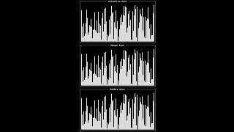
Notes:
Source: https://www.youtube.com/watch?v=ZZuD6iUe3Pc
https://www.youtubeeducation.com/watch?v=3WDWH59k1q4

Slide 194
Notes:
Reload codespace
Uncheck VS Code tabs

